Slide 1
Project #1 Data Processing
NACME-Google AMLI Summer Bootcamp

Slide 2
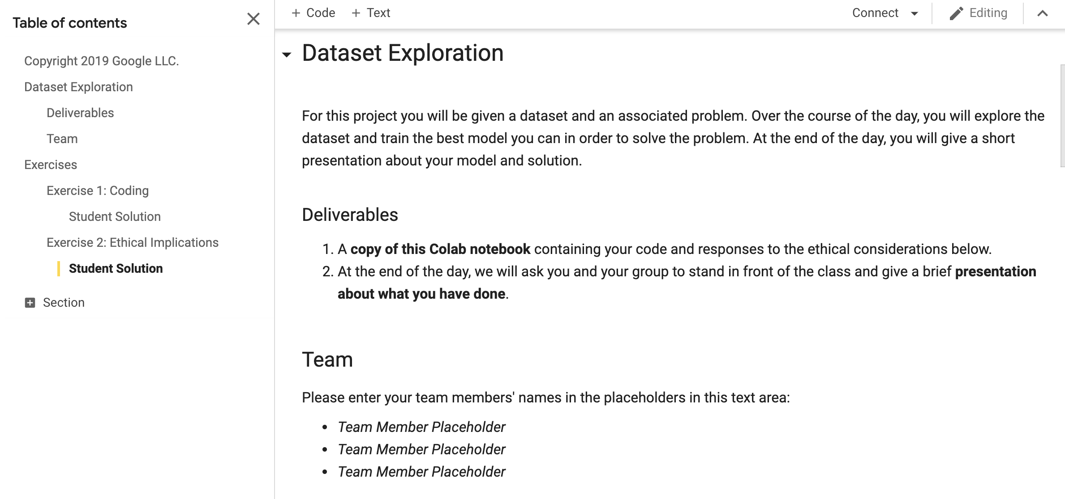
Project 1 – Deliverables

Slide 3
Project 1 – Team Selection
Teams of no more than 4. You choose your own teams (this time).

Slide 4
Project 1 – Due Date
Thursday, June 23rd at 11:59pm

Slide 5
Problem 1 - Definition
Dataset: US airline on-time statistics and delay data (Kaggle) from the US Dept. of Transportation's Bureau of Transportation Statistics (BTS).

Slide 6
Problem 1 - Definition
Dataset: US airline on-time statistics and delay data (Kaggle) from the US Dept. of Transportation's Bureau of Transportation Statistics (BTS).
Goals: use flight statistics data to gain insights into US airports' and airlines' flights in 2008

Slide 7
Problem 1 - Definition
Dataset: US airline on-time statistics and delay data (Kaggle) from the US Dept. of Transportation's Bureau of Transportation Statistics (BTS).
Goals: use flight statistics data to gain insights into US airports' and airlines' flights in 2008
How: use any toolkit (e.g. Pandas, Matplotlib, Seaborn)

Slide 8
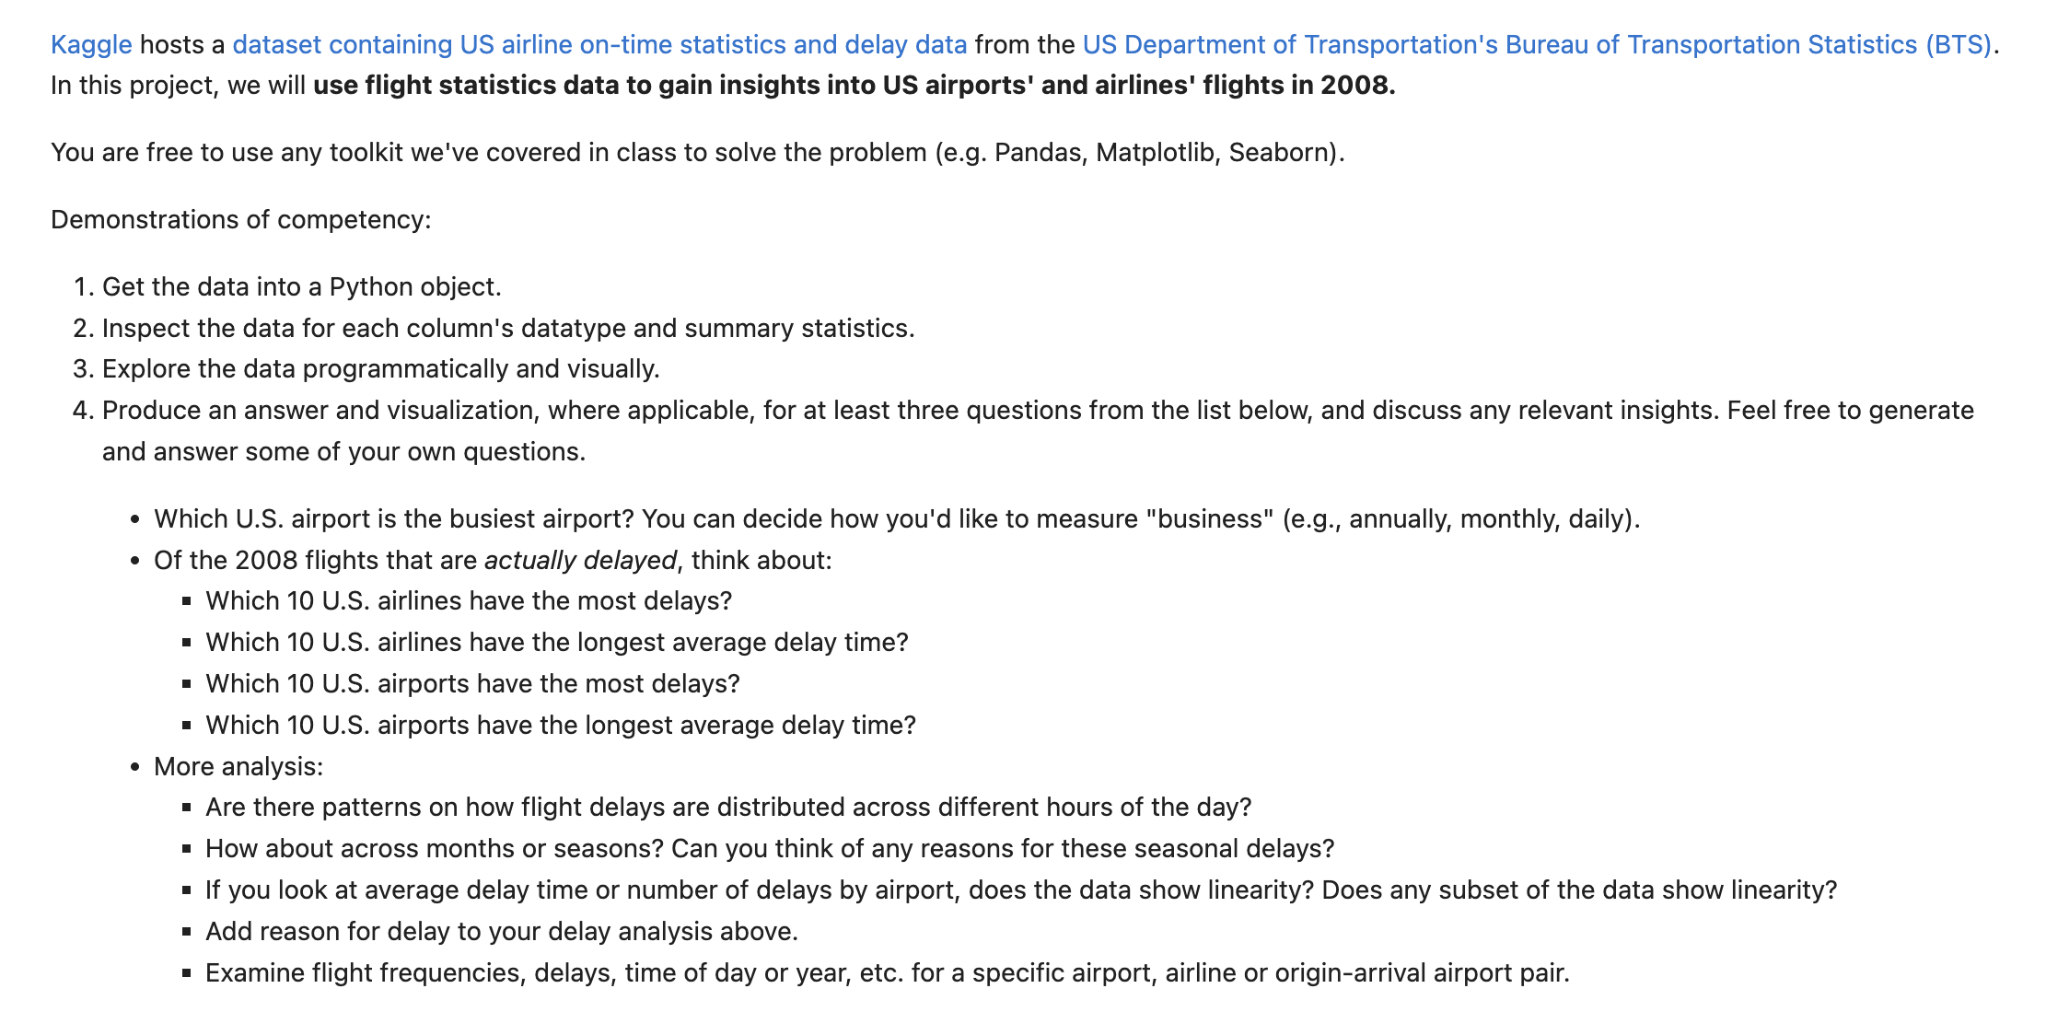
Project 1 – Analysis

Slide 9
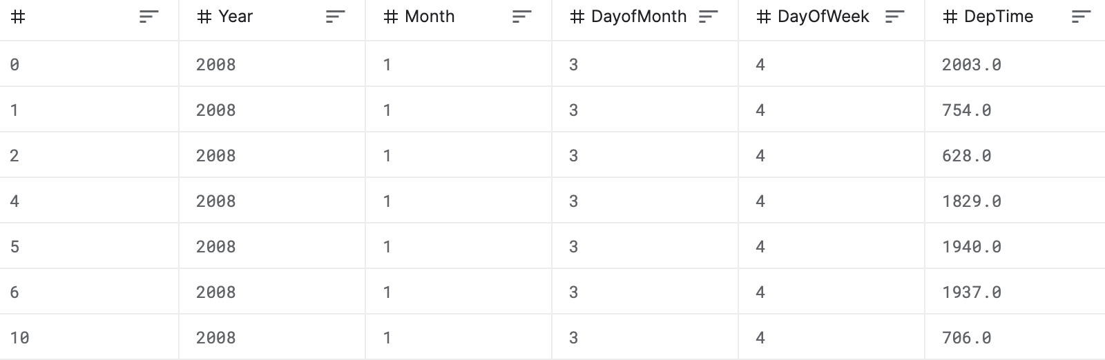
Dataset
Get the data into a Python object.

Slide 10
Dataset
Get the data into a Python object.
Inspect the data for each column's data type and summary statistics.

Slide 11
Dataset
Get the data into a Python object.
Inspect the data for each column's data type and summary statistics.
Hints: use X.describe(), X.columns, X.dtypes

Slide 12
Dataset
Get the data into a Python object.
Inspect the data for each column's data type and summary statistics.
Explore the data programmatically and visually.
Hints: use matplotlib, plot(), show(), groupby()

Slide 13
Dataset
Get the data into a Python object.
Inspect the data for each column's data type and summary statistics.
Explore the data programmatically and visually.
Produce an answer and visualization.
Hints: use matplotlib, plot(), show(), groupby(), sort_values(), seaborn

Slide 14
Problem 2 - Ethical Implications

Slide 15
Problem 2 - Ethical Implications
Problem: Even the most basic of data manipulations has the potential to affect segments of the population in different ways. It is important to consider how your code might positively and negatively affect different types of users.

Slide 16
Problem 2 - Ethical Implications
Problem: Even the most basic of data manipulations has the potential to affect segments of the population in different ways. It is important to consider how your code might positively and negatively affect different types of users.
Goals: In this section of the project, you will reflect on the ethical implications of your analysis.

Slide 17
Problem 2 – Narrative Analysis
Positive Impact

Slide 18
Problem 2 – Narrative Analysis
Positive Impact
Negative Impact

Slide 19
Problem 2 – Narrative Analysis
Positive Impact
Negative Impact
Bias

Slide 20
Problem 2 – Narrative Analysis
Positive Impact
Negative Impact
Bias
Changing the Dataset to Mitigate Bias

Slide 21
Problem 2 – Narrative Analysis
Positive Impact
Negative Impact
Bias
Changing the Dataset to Mitigate Bias
Changing the Analysis Questions to Mitigate Bias

